Slide 1
Adjustments to Income
Pub 4491 – Lesson 18
Pub 4012 – Tab E
Notes:
1
Minor wording changes; enhanced screenshots

Slide 2
Adjusted Gross Income
Total Income minus Adjustments =
Adjusted Gross Income (AGI)
Notes:
2
AGI is important for many tax items
Entitlement to credits – EIC, PTC, ACTC, education credits
Entitlement to deductions – IRA deduction, tuition & fees deduction, medical, miscellaneous

Slide 3
Intake/Interview
Notes:
This lesson will cover some items in detail, not all

Slide 4
In-Scope Adjustments
Educator expenses
Health savings account*
Self-employment tax
Early withdrawal penalty
Alimony paid
IRA contributions
Student loan interest
Tuition and fees
Jury duty pay given to employer
* Optional certification
Notes:
4
Health Savings Accounts – only if certified
If certified in Military, Forms 2106 (for certain expenses of reservist) or 3903 (moving expenses) are also in scope for Military personnel.

Slide 5
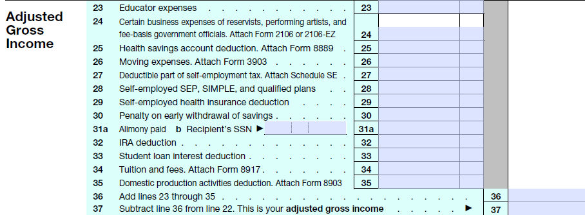
Adjustments to Income
L. 24 In scope for Military
L. 25 In scope for HSA cert.
L. 26 In scope for Military
Out-of-Scope
Notes:
Lines 24 and 26 can be in-scope if certified for Military.

Slide 6
Educator Expenses Line 23
Up to $250 for per educator
classroom materials or
(new) professional development
Must be K–12 teacher, counselor, principal or aide
Must work in a school at least 900 hours during school year
Notes:
PATH made deduction permanent
PATH added professional development expenses related to the curriculum
Expenses to meet minimum for a new job don’t count
Expenses reduced by excluded US bond interest, and nontaxable tuition programs

Slide 7
Educator Expenses Getting to Input Form
Search educator
Or click line 23 in Summary/Print

Slide 8
Educator Expenses Input Form
Enter amount for qualified educators
Amount over $250 is a possible itemized deduction
Notes:
If educator has significantly more than $250 of expenses, may be able to deduct on Schedule A as an unreimbursed business expense IF ITEMIZING (subject to the 2% AGI Floor).

Slide 9
Health Savings Accounts Line 25
Pubs 4942 and 4012 E-2, E-3
Must have high-deductible health plan (insurers identify qualified plans)
Not covered by other general health insurance, including Medicare
Not a dependent of another taxpayer
Open HSA trust account with authorized HSA trustee
Notes:
HSA certification required
Course and test are in Pub 4942
Exceptions to other health coverage:
Workers comp
Coverage re tort or use of property liabilities
Specific disease / illness policies
Fixed per-period hospitalization coverage
Accident coverage
Disability
Dental or vision
Long-term care
Re prescriptions – see pub 969

Slide 10
Health Savings Accounts Line 25
Deduction for contribution to HSA
$3,350 for self-only
$6,650 for family coverage
Plus $1,000 if age 55 or older
Taxpayer and spouse each can have self-only
If also have family coverage, treat as family only
Reduced for employer contributions
Due by tax return due date in April
Notes:
Special rules apply for the year the HSA is set up.

Slide 11
Health Savings Accounts Line 25
Earnings in HSA are not taxed
Distributions not taxed if used to pay medical expenses
Expense must be incurred after HSA set up
No time limit to take distribution
Can let stay in account for years!
State treatment may differ!
Notes:
HSA certification required
Course and test are in Pub 4942

Slide 12
Health Savings Accounts Line 25
Search 8889 or click line 25
Complete Form 8889
Notes:
HSA certification required
Course and test are in Pub 4942

Slide 13
Health Savings Accounts Other Rules
20% penalty for distributions exceeding medical expenses
Can roll from HSA to HSA once per 12 months (unlimited transfers)
Can roll from HSA to IRA (one-time only) see Pub 590-A

Slide 14
Health Savings Accounts Other Rules
Surviving spouse can take deceased spouse’s HSA as their own (in scope)
HSA terminates on death if beneficiary is not the surviving spouse (out of scope)
See Pub 969 for more info

Slide 15
Deductible Part of Self Employment Tax – Line 27
SE Tax = Social Security and Medicare tax for self-employed
Adjustment based on tax shown on Sch SE
Sch SE generated from Schedule C
TaxSlayer handles automatically

Slide 16
Self-Employed Health Insurance Line 29
Line 29 is always out of scope
Includes Medicare premiums
Very complicated if it’s a marketplace policy with a premium tax credit
Taxpayer can choose to claim an itemized deduction for the insurance premiums (not as good)
Can refer to paid preparer

Slide 17
Early Withdrawal Penalty Line 30
Penalty for withdrawal of funds from time deposits, such as CDs
Reported on 1099-INT or 1099-OID
Enter with interest income

Slide 18
Alimony Paid – Line 31a
Pub 4012 E-5
Must be alimony
Must be under divorce or separation decree
Must provide recipient’s Social Security number
Child Support not deductible
Notes:
Must be required by the divorce decree!

Slide 19
Alimony Paid – Line 31a
Search alimony paid
Or click line 31a in Summary/Print
Add more if needed

Slide 20
Individual Retirement Account (IRA)
Two main concepts – don’t confuse them!
Allowable contribution
The most that can be put in
Allowable deduction
The most that can be deducted

Slide 21
IRA Contribution
Allowable contribution can never be more than taxable compensation
Taxable W-2 income, self-employment income, and alimony
Not interest, dividends, pensions, scholarships, unemployment, Social Security
Use combined compensation for limit if filing MFJ
Nonworking spouse can have an IRA!
Notes:
“Compensation” is different than earned income!

Slide 22
IRA Contribution
Age limits
For traditional IRA – under 70½ as of the end of the year
For Roth IRA (includes MyRA) – no age limit

Slide 23
IRA Limit
Contribution and deduction limit
$5,500 ($6,500 if age 50 or over)
For each taxpayer and spouse
If more than one IRA, allowable contribution amount applies to all IRAs (including Roths)
Notes:
A contribution of more than the allowable contribution is an excess contribution subject to a 6% penalty annually until the excess is cured (F 5329)

Slide 24
Non-Deductible Traditional IRA Contributions
If taxpayer or spouse participates in an employer’s plan and/or AGI is too high
Some or all of traditional IRA contribution may be nondeductible
Allowable contribution in excess of deduction becomes basis in the IRA (F8606)

Slide 25
Non-Deductible Traditional IRA Contributions Form 8606
Form 8606 in 2015 return?
Search 8606 and click 8606
Current year nondeductible contribution?
TaxSlayer adds Form 8606 to the return
Notes:
See form instructions for

Slide 26
Non-Deductible Traditional IRA Contributions Form 8606
Enter basis from 2015 F8606, Line 14
F8606 taxable distribution amount is covered in retirement income lesson
Notes:
See form instructions if last filed F8606 is prior to year 2000

Slide 27
IRA Contribution
Taxpayer has until the April due date of the return to make a contribution for the current tax year and still include on this year’s return

Slide 28
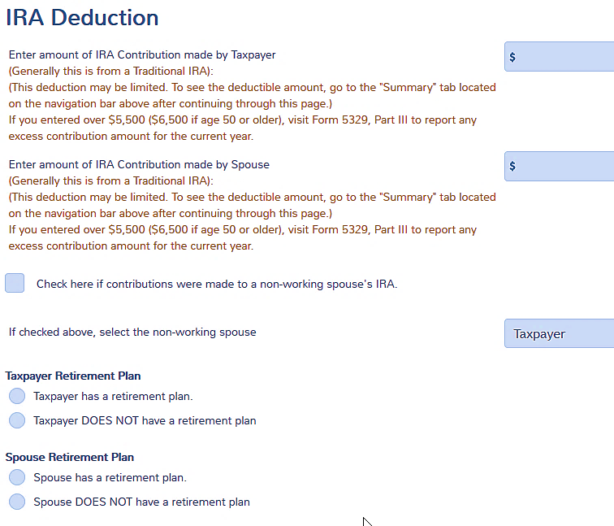
IRA Deduction
Search IRA or click line32 in Summary/ Print
Check if applies
Must check if participating in employer plan – both if MFJ
W-2 box 13 does not carry!

Slide 29
IRA Deduction
TaxSlayer
Computes deduction
Prints IRA Deduction Worksheet

Slide 30
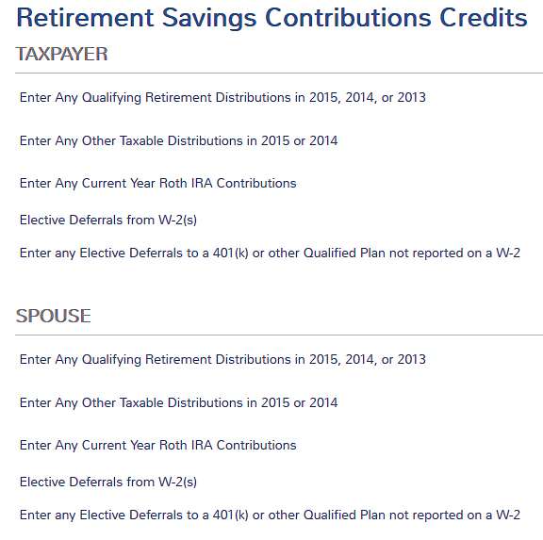
Roth IRA Contribution
Enter Roth contributions on Form 8880 for retirement credit
Search 8880
Later lesson
Note: Roth IRA contribution is not deductible and will not show on line 32
Notes:
Search 8880 in forms box
This is the only place to enter Roth contributions in TaxSlayer

Slide 31
IRA Contribution Limits Caution
TaxSlayer does NOT compute an excess contribution
Check total contributions (traditional and Roth) versus total compensation and maximum amount for age
Can be a mixture of traditional and Roth so long as limit is not exceeded

Slide 32
IRA Contribution Limits Caution
Roth IRA also has a modified AGI limit (regardless of employer plan)
$193,000 for MFJ or qualifying widow(er)
$10,000 for MFS and lived with spouse any time during the year
$131,000 other filing statuses
When MAGI is over this amount, it’s ALL an excess contribution
Notes:
Other filing statuses includes single, head of household and MFS that did not live with spouse at any time during the year

Slide 33
Excess IRA Contribution
If there is an excess contribution
Have until due date of the return to withdraw excess amount
Otherwise, subject to 6% penalty each year until remedied
Out of scope
Notes:
A contribution of more than the allowable contribution is an excess contribution subject to a 6% penalty annually until the excess is cured (F 5329)

Slide 34
Student Loan Interest Line 33
Intake and Interview Sheet – Part IV, Q12
If >$600, should receive Form 1098-E

Slide 35
Student Loan Interest Line 33
Pub 17, Ch 19
Interest paid on qualified student loan for post secondary education expenses
Qualified loan:
Expenses of taxpayer, spouse, or dependent (when loan originated)
For education expenses paid within reasonable time since loan was opened
For education provided when student enrolled at least ½ time in degree program

Slide 36
Student Loan Interest – Line 33
Qualified Loan (cont.)
Loan cannot be from relative
Taxpayer cannot file MFS
Not a dependent on someone else’s return
Loan cannot be from qualified retirement plan
Taxpayer must be liable on the loan

Slide 37
Student Loan Interest – Line 33
Maximum $2,500 per year
Phases out as AGI increases

Slide 38
Student Loan Interest Line 33
Search student in forms box or click line 33 in Summary/ Print
TaxSlayer calculates the maximum deduction and prints student loan interest deduction worksheet

Slide 39
Tuition and Fees – Line 34
Up to $4,000 adjustment allowed per return (less based on AGI)
For qualified education expenses of higher education
One of several choices for education benefits (often not the best choice)
Will cover details in education benefits lesson later

Slide 40
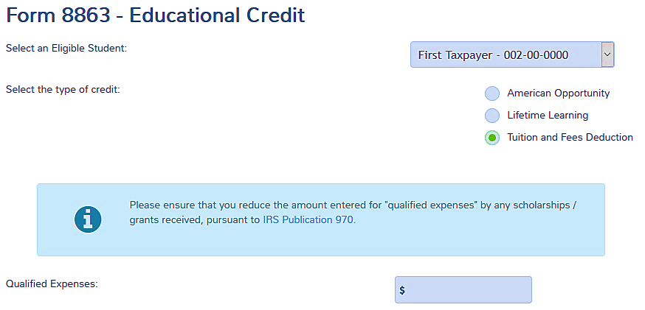
Tuition and Fees Deduction Line 34
Search education or click line 34
TaxSlayer calculates the maximum deduction
Notes:
TaxSlayer do not optimize among the various education benefits.
See education benefits lesson

Slide 41
Jury Duty Pay Turned Over to Employer
Some employers keep paying employee while they’re out on jury duty
Employee has to turn over any jury pay received for those days
Must show jury pay received on Line 21, Other Income (do not include expense reimbursements)
Claim an adjustment to reduce AGI
Notes:
41
41
All other items on line 35 are out of scope

Slide 42
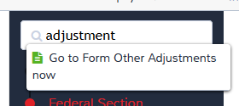
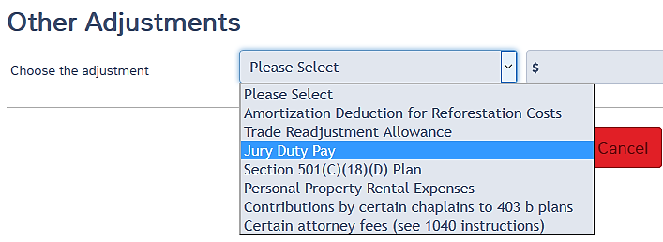
Jury Duty Pay Turned Over to Employer
Search adjustment in forms box
Select jury duty pay and enter amount turned over
Notes:
42
42
All other items on line 35 are out of scope

Slide 43
Adjustments Quality Review
Does 1040 page 1 reflect adjustments properly
Compare with Intake/Interview Sheet
Compare with last year’s return
Were other forms generated that should be addressed

Slide 44
Exit Interview
Does taxpayer need to finish their IRA contributions for 2016?
Make a BIG note on the documents envelope

Slide 45
Adjustments to Income
Comments
Questions

